Slide 1


Ideas Wanted
Hajji Khalil

Slide 2


Open questions
How can we take profit of this data?
This data can be used to learn user behaviours to:
Make the smartphone make some automatic decisions and actions
Recommend some useful things to the user
What actions ?
What recommendations?
What applications can this data enable us to acheive?

Slide 3

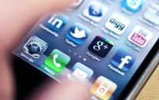


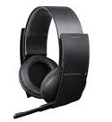
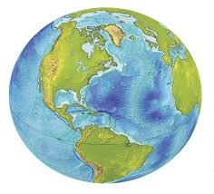







Dataset Description
Bluetooth:
The devices currently detected by smartphone
The devices currently connected to smartphone
AppLaunch:
All applications launched from the smartphone
USB:
Wether usb devices are currently connected to smartphone
Notifications:
All the notifications received by the smartphone
Headset:
If a headset is currently connected to smartphone
Locations:
Different locations visited by a user
72 different gps coordinates per day
Wi-Fi routers:
The routers currently detected by smartphone
The router to which the smartphone is connected
The connectivity state of smartphone
User Activity:
Walking
Running
In a car
In a bicyle
28 different activity per day
Smartphone Settings:
All the current settings of the smartphone
Wheater:
Information about the current weather

Slide 4

I want to hear it all!
What applications can this data enable us to acheive?
How can we take profit of this dataset ?

Slide 5
What applications can this data enable us to acheive?
Bluetooth:
The devices currently detected by smartphone
The devices currently connected to smartphone
AppLaunch:
All applications launched from the smartphone
USB:
Wether usb devices are currently connected to smartphone
Notifications:
All the notifications received by the smartphone
Headset:
If a headset is currently connected to smartphone
Locations:
Different locations visited by a user
72 different gps coordinates per day
Wi-Fi routers:
The routers currently detected by smartphone
The router to which the smartphone is connected
The connectivity state of smartphone
User Activity:
28 different activity per day
Smartphone Settings:
All the current settings of the smartphone
Wheater:
Information about the current weather

Slide 6

Many Thanks!
Google doc where you can post all your ideas

